Slide 1
DEPLOYING WORDPRESS WEB APPLICATION USING DOCKER IN AMAZON WEB SERVICE
AJAY D

Slide 2
Module:1 : creating and launching an amazon linux Ec2 instance
EC2: Amazon Elastic Compute Cloud is a part of Amazon.com's cloud-computing platform, Amazon Web Services, that allows users to rent virtual computers on which to run their own computer applications.
choose amazon machine image
Select instance type
Choose keypair
Select network settings
Choose security groups
Add storage
Review and launch

Slide 3
module2: installing git and docker and related repos
Docker: Docker is an open platform for developing, shipping, and running applications. Docker enables you to separate your applications from your infrastructure so you can deliver software quickly. With Docker, you can manage your infrastructure in the same ways you manage your applications.
Git: Git is a DevOps tool used for source code management. It is a free and open-source version control system used to handle small to very large projects efficiently. Git is used to tracking changes in the source code, enabling multiple developers to work together on non-linear development.
Docker-compose: Compose is a tool for defining and running multi-container Docker applications. With Compose, you use a YAML file to configure your application's services. Then, with a single command, you create and start all the services from your configuration.

Slide 4
Continue ..
Install git and docker
Start the docker and enable it
Give permissions to add a user account
sudo usermod –a –G docker ec2-user
install the docker-compose
Apply executable permissions
sudo chmod +x /usr/local/bin/docker-compose

Slide 5
module3: creating wordpress setup for docker images with the help of yaml scripting
Wordpress: WordPress is a content management system (CMS for short). It's a robust tool for creating and managing your website. Blogs, business websites, personal sites, and ecommerce stores alike can benefit from using WordPress. This platform is run online, meaning you don't need to download any desktop software to use it
Create a docker-compose file
In docker-compose file enter docker-compose.yaml code
run the sudo docker-compose up –d command for puling the images are MYSQL and WORDPRESS

Slide 6
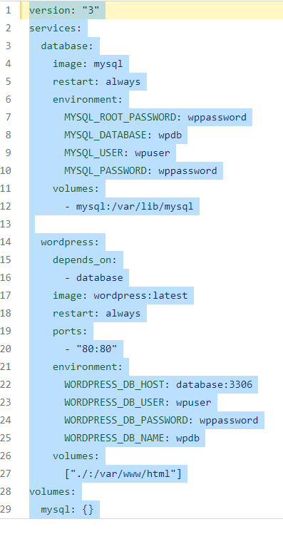
Sudo Vi docker-compise

Slide 7
Push the docker-compose.yaml file into git hub
make a folder
Sudo mkdir <name>
Initialize the folder by below command
Sudo git init <folder name>
Create remote repo with same name as local repo with out add readme. File

Slide 8
CONTINUE...
In terminal, Change name of git branch from master branch to main branch by using command
git branch –M main
give the connction to remoterepo to local repo
git remote add origin <URL of your remote repo>
push your file local branch to remote repo
git push –u origin main
It will ask user name and password
then check it in github

Slide 9
2. DEPLOYING WORDPRESS WEB APLLICATION USING JENKINS IN AMAZON WEB SERVICES
Launch EC2 instance with Amazon Linux 2 AMI and required security group for JENKINS
connect ssh client into terminal
update the system
install git by using below command
sudo yum –y install git
install the java-11* version by command
sudo yum –y install java-11*

Slide 10
Install the Jenkins
sudo systemctl start jenkins
sudo systemctl enable jenkins
select installed plugins
Create new item
In job, clone the code of docker-compose.yml from git hub
save it and build now

Slide 11
Docker install
sudo yum –y install docker
give permission to docker group
sudo usermod –aG ec2-user
start the docker service and enable service
sudo systemctl start docker
sudo systemctl enable docker
Install docker-compose using below command
Sudo curl –L http://github.com/docker/compose/release/download /latest/docker-compose-S(uname -s)-S(uname -m) -o /usr/local/bin/docker-compose

Slide 12
give executable permission
Sudo chmod +x /usr/local/bin/docker-compose
create a symbolic link
ln -s /usr/local/bin/docker-compose /usr/bin/docker-compose

Slide 13
Create New job in JENKINS
Create another job select copy from previous job
In build section select Execute shell
In Excute shell give command for pulling the images from docker hub
sudo docker-compose up –d
save it and build now

Slide 14
In Terminal
check the docker container using
sudo docker ps
Copy public IP of instance and check word press running or not

Slide 15
DEPLOYING WORDPRESS WEB APLLICATION USING SHELL SCRIPTING IN AMAZON WEB SERVICES
Creating and Launching an Amazon Linux EC2 instance
choose ami
Choose Instance type and Choose key pair
Networking setting (select VPC and Subnets) and Select Security Group

Slide 16
CONTINUE....
Add storage and select no. of instance (if required)
go to advance details and write the bash scripting
launch the instance
Copy the public IP and check the word press

Slide 17
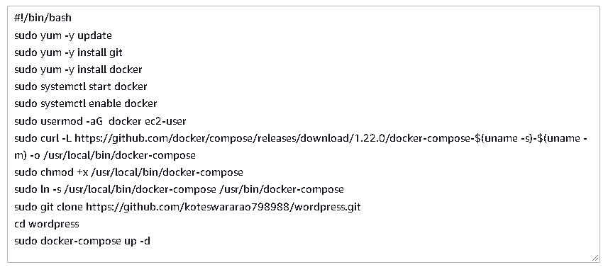
USER DATA

Slide 18
THANK YOU

